Slide 1
Support for Mission Critical How Roles Work Together
Version 4.0 Collab – March 2024
Notes:
V1.2 RELEASED with Comments removed

Slide 2
Role glossary used in this deck
Role within SfMC Delivery | MS Role Title
SfMC Customer Lead (SfMC CL) | CSA (from SfMC team)
SfMC Co-Customer Lead (SfMC Co-CL) | CSA (from SfMC team)
SfMC CSAM | CSAM (Area CSU or SMC&D)
SfMC Enhanced Designated Engineer (SfMC EDE) | CSA (from Area CSU, VDM and/or SfMC team)
SfMC Services Engineer (SfMC CSA or SfMC EDE) | CSA (from Area CSU, VDM and/or SfMC team)
SfMC CSA Presales and Delivery Excellence (SfMC CSA P&DE) | CSA (from SfMC team)
SfMC CSA Manager | CSA Manager (from SfMC team)
SfMC CSAM Manager | CSAM Manager (Area CSU or GAMD)

Slide 3
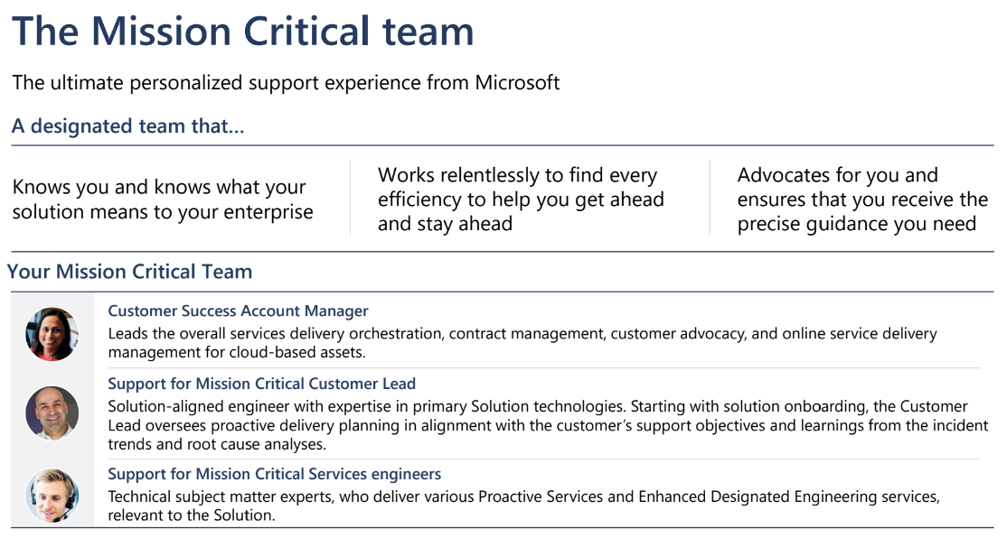

Slide 4
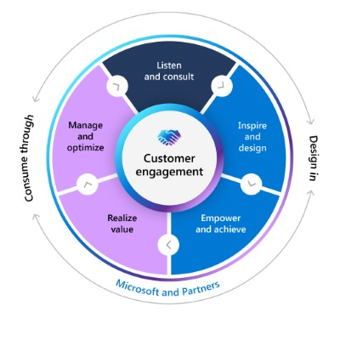
MCEM methodology alignment in SfMC Delivery
MCEM: Listen and consult
Pre-sales engagement
MCEM: Inspire and design
Pre-sales engagement
MCEM: Empower and achieve
Contract setup and guidance
Assess and plan
MCEM: Realize value
MCEM: Manage and optimize
Assess and Plan
Optimize and Remediate
Restore and Protect
MCEM in SfMC
All phases of the MCEM methodology are applicable to SfMC deliveries. The defined role contributions are available in the ‘FY24 MCEM Orchestration Guide.’ The partnership between the CSAM and CSA is imperative to drive the best customer outcomes. The MCEM methodology underpins the customer engagement lifecycle.
Phase 1: Listen and consult
Role: Pre-Sale and Delivery Excellence CSA
Phase 5: Manage and optimize
Role: SfMC CL, CSAM, EDE
Phase 2: Inspire and design
Role: Pre-Sale and Delivery Excellence CSA
Phase 3: Empower and achieve
Role: Pre-Sale and Delivery Excellence CSA and SfMC CL
Phase 4: Realize value
Role: SfMC CL, CSAM, EDE
Resources:
Microsoft Customer Engagement Methodology - Home (sharepoint.com) FY24 MCEM Orchestration Guide - Enterprise.pptx (sharepoint.com) FY24 MCEM Activity Guide.pptx (sharepoint.com)

Slide 5
SfMC CSAM and SfMC Customer Lead

Slide 6
CSAM Relationship
Why it is important?
The CSAM and SfMC Customer Lead (SfMC CL) work together proactively to enable a stable and robust solution to achieve the customer’s business objectives.
CSAM Role
The CSAM is the delivery leader in our account team and strategic partner to our Customers. CSAMs are responsible for Execution against our Customer Success Contracts and orchestration of cross-functional programs that deliver Customer value and enable transformational Customer outcomes.
Key Responsibilities in SfMC Delivery
Manages the customer relationship and delivery management and sets customer expectations around SfMC scope, capability, and value.
Shares in depth knowledge of the customer’s objectives and priorities, high-level SfMC solution and contractual obligations.
The CSAM collaborates with SfMC Customer Lead on any SfMC Support Delivery Projects to achieve identified Mission Critical outcomes.
The CSAM is responsible and accountable for all Support Delivery Projects and must validate it against the Customer Success Plan.
Accountable for formulating a delivery plan in partnership with SfMC CL and driving health reviews, and stakeholder reviews to surface ongoing opportunities .
In partnership with SfMC CL, accountable for timely SfMC assessments completion, contract consumption, cloud consumption and delivery management administration.
CSAM schedules and orchestrates CSDR and other governance meetings and invites SfMC CL where required, they are also accountable for the CSP creation and delivery plan alignment.
Accountable for MIRP creation and completion with collaboration with the SfMC CL.
CSAMs are accountable for driving UCR/consumption and supporting roles such as the SfMC CLs and EDEs are responsible to make contributions and keep the customer account on track.
The CSAM is accountable to coordinate and track EDE deliveries.

Slide 7
SfMC Customer Lead Relationship
Why it is important?
The CSAM and SfMC Customer Lead (SfMC CL) work together proactively to enable a stable and robust solution to achieve the customer’s business objectives.
SfMC Customer Lead
The SfMC CL brings deep technical knowledge and “know me” of overall customer solution and contributes to business goals. They deliver solution-oriented proactive services to ensure solution reliability, stability and optimal performance. They provide deep knowledge and “know me” of overall customer solution architecture and business goals resulting in faster resolution of reactive incidents through collaboration with other support teams.
Key Responsibilities in SfMC Delivery
Provides ongoing input to create and develop SfMC Support Delivery Project(s), via solution knowledge, RCA recommendations and collaboration on identifying Support Needs.
Demonstrates the ongoing value of SfMC in collaboration with the CSAM.
Provides monthly updates and reports to CSAM for input into Support Delivery Projects & Customer Success Delivery Review (CSDR).
Partners with CSAM on customer onboarding, delivery, and renewal.
Supports contract usage, cloud consumption, CPE, and revenue growth, through delivering solution improvements in reliability, stability, and a decrease in reactive incidents.
SfMC CL attends and provides input to CSAMs for CSDR or other governance meetings.
Identifies opportunities for upsell of services in alignment with technology and solution goals as well as analysis of reactive incidents and RCAs.
Contributes and follows up on the MIRPs with the CSAM

Slide 8




CSAM / SfMC Customer Lead Relationship
Who brings what to the table: The CSAM is accountable for the overall customer relationship and delivery management of the proactive Customer Success program, including contractual oversight, usage, and renewals. The CSAM leads customer discussions to understand their business goals and works with the SfMC CL to orchestrate delivery of the SfMC engaged Support Delivery Projects. The SfMC CL brings deep technical knowledge and “know me” of overall customer solution and contributes to business goals. What’s the relationship rhythm: The CSAM and SfMC CL partner on delivery of the SfMC contract and exhibit obligations to the customer through regular meetings. These include internal SfMC Delivery Check-ins/SfMC Delivery Health Reviews with active participation of CSAM Manager and SfMC CSA Manager, as well as customer facing CSDR for the SfMC Support Delivery Projects. The CSAM and SfMC CL work hand in hand to surface opportunities to deliver SfMC value.
CSAM Role Stats |  | SfMC CL Role Stats
Objectives and Key Results: Customer Satisfaction Renewals/Usage Key Relationships: SfMC CL, CSM, STU, CSS/IM, ADE, DA, SE, Delivery Partners, Engineering, Fasttrack, GBB, OCP, CSA-Manager |  | Objectives and Key Results: Customer Satisfaction Renewals/Usage Key Relationships: CSS, IM, Engineering, EDEs, ISD, CSA/CSM, GBB, SSSP, CSAM-M, CT
* The CSAM will mostly engage with the SfMC CSA Customer Solution Lead or Co-lead for the accountabilities listed here

Slide 9
SfMC CSAM Manager and SfMC CSA Manager

Slide 10
SfMC CSAM Manager / SfMC CSA Manager Relationship
Why it is important?
To achieve customer outcomes and to provide a cohesive customer experience the SfMC CSAM Manager and SfMC CSA Manager need to work together and lead their teams in strategic alignment from planning, delivery to confirming value.
SfMC CSAM Manager Role
Leads a team of CSAMs in driving Customer experience and outcomes through portfolio management and delivery, solution optimization and operational health outcomes.
SfMC CSA-Manager Role
Lead and coaches a team of SfMC CL(Support) to accelerate/optimize consumption, modernize support experience, and drive technical intensity for customers through an easy and trusted CCE (Support).
Key Responsibilities in SfMC Delivery
SfMC CSAM Manager is accountable for the SfMC CSAMs involved in Mission Critical customer deliveries
Share relevant business, customer, and personnel status and opportunities to ensure alignment with ongoing Customer Success priorities
Partner with SfMC CSA Manager to plan and review relevant Customer status and opportunities resulting from Program and Executive Reviews to ensure successful SfMC delivery and UCR.
Provide a primary point of management escalation for delivery governance, resource alignment, escalation management, and customer feedback
Collaborate on evaluating Well Architected practices and coach teams to share success stories to drive landing and adoption of cloud services
SfMC CSAM Manager to ensure appropriate SfMC handover is actioned between SfMC CSAMs during account transition
Key Responsibilities in SfMC Delivery
SfMC CSA Manager is responsible for the SfMC CL and SfMC EDE (when resourced from SfMC Team) in Mission Critical deliveries
Partner with SfMC CSAM Manager to plan and review relevant Customer status and opportunities resulting from Program and Executive Reviews to keep Delivery Health of SfMC on target
Engage SfMC CSAM Manager on delivery governance, orchestration, resource alignment, escalation management, and customer feedback
Collaborate on evaluating Well Architected practices and coach teams to share success stories to drive landing and adoption of cloud services
SfMC CSA Manager to ensure appropriate SfMC handover is actioned between SfMC CL during account transition

Slide 11
SfMC CSAM Manager / SfMC CSA Manager Relationship
Who brings what to the table: The SfMC CSAM Manager drives customer experience, business outcomes and usage through strong delivery leadership, management escalation and feedback. Facilitates connection with manager peers across the ATU, STU and CSU to deliver a Connected Customer Experience across the customer lifecycle, across the entirety of the Customer Success Plan. The SfMC CSAM Manager is accountable for supporting their SfMC CSAM in unblocking customer challenges and supporting the SfMC CSAM for customer escalations, as well supporting non-SfMC resourcing escalations. The SfMC CSA Manager is responsible for the overall day to day running of the Mission Critical Delivery. Their responsibility is maintaining the technical quality of the delivery and assisting in unblocking internal delivery challenges. Ensuring that customer technology needs are balanced with expertise to support the SfMC CSAM drive customer business outcomes and consumption. What’s the relationship rhythm: The SfMC CSAM Manager and SfMC CSA Managers maintain a regular connection on opportunity pipeline, planning, execution, optimization of current workloads/environments through Well Architected/operational health. They partner in Customer Success Delivery Review (CSDR) as appropriate.
SfMC CSAM Manager Role Stats |  | SfMC CSA Manager Role Stats
Objectives and Key Results: Change Leadership Customer Satisfaction Enable cross cloud/solution area/workload across customer journey Key Relationships: CSA Managers across CSU, CTL, CSA, CSM, CSS, STU, GBB, ISD, Delivery Partners, Engineering, Fasttrack, CSE, GPS (ex-OCP) |  | Objectives and Key Results Team Upskilling Staffing, CSA (Support) Utilization, support workforce plan and Operational Excellence Enable cross cloud/solution area/workload across customer journey Key Relationships Managers across CSAM, CSA, STU, GBB, Engineering, Fasttrack, CSE, GPS (ex-OCP), Partners/ISD
* The CSAM will mostly engage with the SfMC CSA-E Customer Solution Lead or Co-lead for the accountabilities listed here

Slide 12
Additional Resources
Support Portfolio
Enhanced Support Playbook
Value of SfMC – ROI Case Study

Slide 13
Change Log/Future Iterations
Version | Date | Comments
1.0 | 23 April 2022 | First release
2.0 | November 2022 | Updates on: Role title updates for FY23 Inclusion of SfMC CSA (Pre-sales and delivery Architects) activities. Minor content updates
3.0 | February 2023 | Template update to align with standard HRWT deck. Minor terminology update (e.g. DSE → EDE, SDP → Support Delivery Project) Updates to SfMC CSA role Updates to Customer Lead and CSAM role responsibilities
4.0 | TBD | Role names updated Activity Guide Alignment and MCEM changes to SfMC Updates made on the CSAM and CSA role referencing MIRPs, URC/consumption and ownership of the CSP Clarification on RCAs

Slide 14
Appendix slides
The following slides outline different activities performed by various SfMC Delivery roles through different stages of SfMC Contract outlined below.
This content will be moved to SfMC Hub when available.
Assess and Plan
Optimize and Remediate
Restore and Protect
Contract Setup

Slide 15
Contract Setup
SfMC CSAM | SfMC CSA (SfMC Customer Lead) | SfMC CSA (SfMC EDE) | CSA Manager (SfMC CSA Manager) | SfMC CSA (SfMC CSA P&DE)
Ensure EDE staffing requests have been accepted and resources allocation is complete’C. Review and complete SfMC Service Activation Assigned Tasks http://aka.ms/viki related to contract setup. For example: Identify and test dedicated SfMC Hotline telephone number Create/Review/Update the Customer Call Logging Quick Reference Guide M365 Tenant / Azure Subscription preparations for SfMC cases and CSPM (previously CKP) mapping Add/verify individual roles (SfMC EDE and SfMC Customer Lead) as “Co-Owners” to the Customer container in RMEx (for non-SMC/B customers) to enable collaboration on SfMC Support Delivery Project(s) planning and delivery | Review and complete SfMC Service Activation Assigned Tasks http://aka.ms/viki related to contract setup | No Action | Review and complete SfMC Service Activation Assigned Tasks http://aka.ms/viki related to contract setup | Conduct Sales to Delivery Handover for new contracts to share background, scope, deal info, risk and mitigation. Discuss SfMC schedule renewal with Seller, SfMC CSAM and SfMC Customer Leads latest at T-90 (90 days before expiry at the latest) Complete delivery quality and excellence tasks as setup and assigned in VIKI Service Activation tasks list

Slide 16
Assess and Plan
SfMC CSAM | SfMC CSA (SfMC Customer Lead) | SfMC CSA (SfMC EDE) | CSA Manager (SfMC CSA Manager) | SfMC CSA (SfMC CSA P&DE)
Provide business strategy and information input to the SfMC assessments Contribute to Customer KnowMe Introduce assigned EDEs to the customer and work in partnership with SfMC CL to define their cadence and activities to support SfMC delivery. Coordinate collaboration/handover call with Industry Solutions Delivery (if applicable) Schedule dispatches for all assessment items per SfMC package Schedule and facilitate meetings with the customer, SfMC Customer Lead and SfMC EDE to deliver SfMC assessment findings Update RMEx Customer container and SfMC packages access to enable SfMC Customer Lead collaboration with assessments Schedule all Support Delivery Project dispatches for identified activities to ensure targeted contract consumption Provide customer facing monthly reports and schedule/conduct regular delivery planning with the customer Review and complete Assess and Plans tasks assigned to SfMC CSAM in http://aka.ms/viki | Update KnowMe entry and Workload record(s) for this Solution and populate fields to facilitate accurate case alerting and routing Delivery of SfMC Assessments: Discovery Assessment Optimization Assessment Supportability Assessment Own the completion of the KnowMe with Customer Supported Products and any solution resource information from completed assessments Provide input to the SfMC Support Delivery Projects and scheduling activities Participate in monthly customer meetings with the SfMC CSAM Review and complete Assess and Plans tasks assigned to SfMC Customer Lead in http://aka.ms/viki | Provide input/review of the KnowMe entry Assist and/or deliver SfMC Assessment activities: Discovery Assessment Supportability Assessment Optimization Assessment Provide input to building the SfMC engaged Support Delivery Project Update the delivery tracker every month with planned, proposed and delivered activities for the SfMC CSAM and SfMC Customer Lead to use in monthly reporting Where relevant, participate in monthly customer meetings with the SfMC CSAM | Sign off on Customer KnowMe documentation Notified of assessments not completed in the first 90 days of the contract start date (SfMC CSAM-M & CSA Manager need to be notified via email) Ensure SfMC CSAM is assigned to the appropriate SfMC Distribution Lists | Support SfMC Customer Leads in defining plan for SfMC Support Delivery Projects as needed

Slide 17
Optimize and Remediate
SfMC CSAM | SfMC CSA (SfMC Customer Lead) | SfMC CSA (SfMC EDE) | CSA Manager (SfMC CSA Manager) | SfMC CSA (SfMC CSA P&DE)
Schedule and facilitate Support Delivery Project deliveries (i.e., Workshops, assessments & other MIPs etc.) Schedule and facilitate onsite visits Maximize customer value by optimizing contract usage e.g. SKU swaps Deliver monthly reporting via CSDR and delivery planning with the customer Facilitate a monthly internal sync with the SfMC Customer Lead and SfMC EDE Drive regular internal delivery excellence and SfMC package usage reviews. | Deliver relevant/accredited SfMC proactive services Perform onsite visits (including SfMC CSAM and SfMC EDE if available) and continue to provide proactive recommendations to the customer to ensure SfMC value is delivered Regularly update the SfMC solution documentation in KnowMe Attend monthly internal sync with the SfMC CSAM and SfMC EDE Deliver internal service reviews along with CSAM Deliver remediation activities, possibly in collaboration with SfMC EDE Identify trends, analyze, and coordinate delivery opportunities within the SfMC scoped solution and communicates to CSAM Optimize SfMC scoped solution and help customer with digital transformation, adopting features, and business growth related to this solution | Provides input to: Bi-weekly calls with customer Monthly customer reporting Monthly internal sync Performs proactive services (RaaS/ODAs etc.) if applicable as per SfMC engaged Support Delivery Project Assist SfMC Customer Lead in delivery of remediation activities (brown bags, etc.) | Investigate the issues for account health reviews that are red Attend executive level customer meetings, where agreed | Set up and conduct delivery health reviews of the SfMC schedules 6 -8 months from start of current SfMC schedule . The delivery health reviews are worked along with SfMC CSAM and SfMC Customer Leads and cover review of: SfMC specific Support Delivery Projects SfMC schedule utilization OKRs Actions Support SfMC Customer Leads on remediations from the RCAs Support SfMC Customer Leads in writing customer success stories Complete delivery quality and excellence tasks as setup and assigned in VIKI Service Activation tasks list

Slide 18
Restore and Protect
SfMC CSAM | SfMC CSA (SfMC Customer Lead) | SfMC CSA (SfMC EDE) | CSA Manager (SfMC CSA Manager) | SfMC CSA (SfMC CSA P&DE)
Set up CritSit portal notifications Update handling instructions CritSit tool With the support of the SfMC Customer Lead, conduct a smoke test to ensure accurate contract and Flash set up Case management (or via IM+ where available) Provide customer recommendations following RCA completion, as prepared by SfMC CL. Include RCA recommendations as commit to complete or pipeline contribution and incorporate within the Support Delivery Project. Recommendations should be captured in the customer's improvement plan. Manage customer expectations around SfMC reactive support and CSS/SfMC engagement. Manage customer expectations around correct entitlements for SfMC out-of-scope cases. | Update CritSit Handling and Customer KnowMe including CritSit bridge info Consult with the SfMC CSAM to set up the KnowMe correctly (in scope/out of scope technologies for SfMC) Support customer CritSit smoke test Provide case trend analysis and recommend remediation activities during the biweekly customer reviews Provide advisory support with deep technical focused analysis and a “know me” understanding of the customer’s technology and solution Responsibility for driving towards a stable and robust solution and minimize reactive demand and time to recovery. CSAs will contribute to the CSDR via resiliency recommendations following RCAs (Job 1 and Job 2) CSAs will consider people and process recommendations Involve SfMC CSA P&DE for review as needed. | Gather information to assist on support cases (note: CSS own the case resolution) | Awareness of CritSits and customer/account team escalations | Review critsit RCA for quality where a review is requested by SfMC Customer Lead or SfMC CSA Manager. When an RCA review is requested focus on the recommendations and ensure that the actions are actionable and followed through. Support SfMC CL to help unblock activities that may prevent RCA completion. Support SfMC CL and CSAM to help scope the potential opportunities for renewal discussions or net new SfMC workloads.

